Slide 1
Face Segmentation Florian Bettini – Maxime Lutel – Gabriel Muller – Benjamin Pommier

Slide 2
TABLE OF CONTENTS
The topic. What are we doing ? > Objective & Datasets & Related work --- Floby
Why is it interesting ? Problematic & applications --- Gab’
Presentation of the Pipeline --- Pom’
Zoom différents éléments: experiments & results
Face detection --- Gab’
Features extraction : probability maps --- Pom’
Features extraction : other features (edge, pooling, segmentation, threshold) --- Lulu
Face segmentation : results & experiments > nombre et type de features, # d’observations, photos differentes (autres datasets) --- Lulu
Gender & Head Pose --- Floby
Conclusion & Next Steps --- Pom’

Slide 3
TABLE OF CONTENTS
Face segmentation – Introduction
A
Applications
B
The Pipeline
C
Experiments & results
D
Conclusion & next steps
E

Slide 4
REPORT
Abstract --- (later)
Introduction & Motivation (use PP) --- Gab’
Problem definition (use slide 1. & 2.) --- Floby
Related work (use PP) --- Gab’ & Floby
Methodology > Presentation of the Pipeline --- Pom’
Experiments & results
Face detection --- Gab’
Features extraction : probability maps --- Pom’
Features extraction : other features (edge, pooling, segmentation, threshold) --- Lulu
Face segmentation : results & experiments > nombre et type de features, # d’observations, photos differentes (autres datasets) --- Lulu
Gender & Head Pose --- Floby
Conclusion & Next Steps ---

Slide 5
INTRODUCTION
Face segmentation: what is it ?

Slide 6
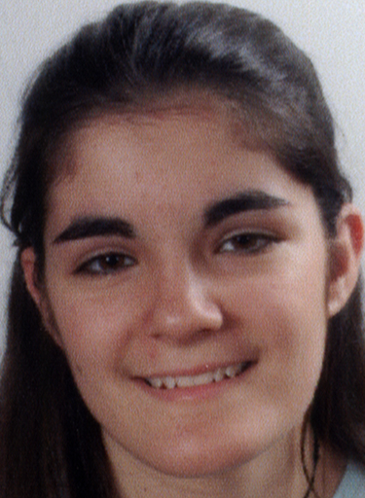
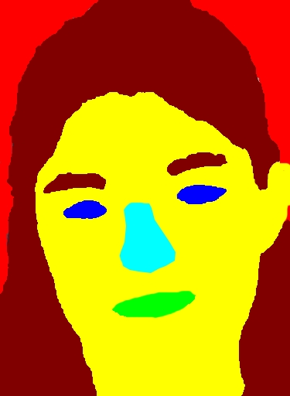
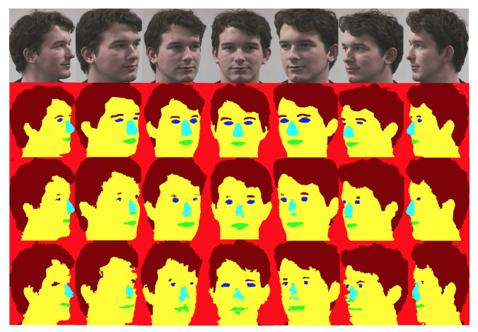

FACE SEGMENTATION
Objective
Implement a multiclass face segmentation algorithm capable of extracting from a person’s figure the eyes, mouth, nose, hair and skin through the use of computer vision and machine learning …
Illustration
Datasets
Related work
Yacoob and Davis (2006) - hair labelling
Khan et al (2015) - random forest classification for face segmentation
Original image
Desired output
FASSEG dataset
~ 200 labeled faces / 7 poses
Own pictures for robustness
Benini et al (2017) - head pose estimation with deep learning

Slide 7
APPLICATIONS
For what purpose ?

Slide 8
APPLICATIONS
Objective
… and to apply it to …
Gender detection
Head Pose estimation

Slide 9
THE PIPELINE
What did we use ?

Slide 10
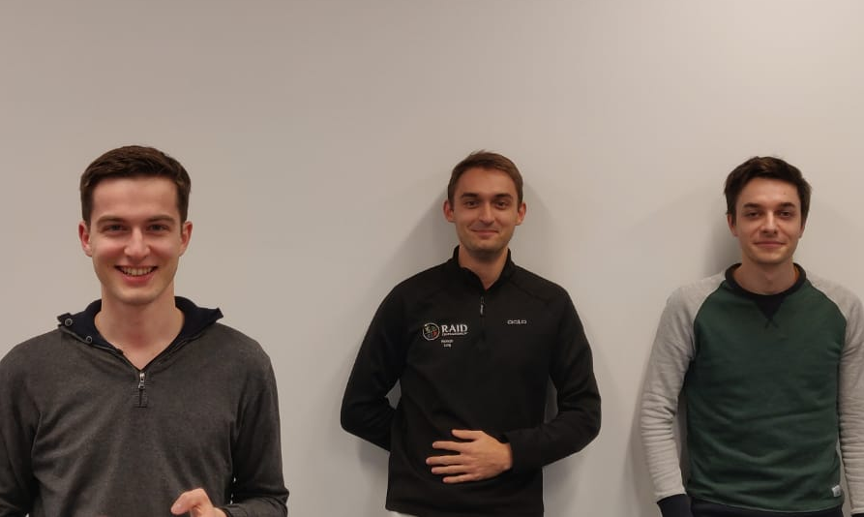
PIPELINE USED TO GENERATE THE USE CASES
1
2
3
4a
4b
Gender detection
4a
Capitalizing on the extracted face segmented to detect the gender
Face
dectection
1
Features extraction
2
Face
segmentation
3
Isolation of the faces in an image
Haar Cascade
Probability maps extracted with:
HoG
Pixel location
HSV histograms
RandomForest
Xxxx ?
Training & testing of a supervised model to classifify each part of the face
Head Pose Estimation
4b
Determination of the gaze direction

Slide 11
EXPERIMENTS & RESULTS
What is the output ?

Slide 12
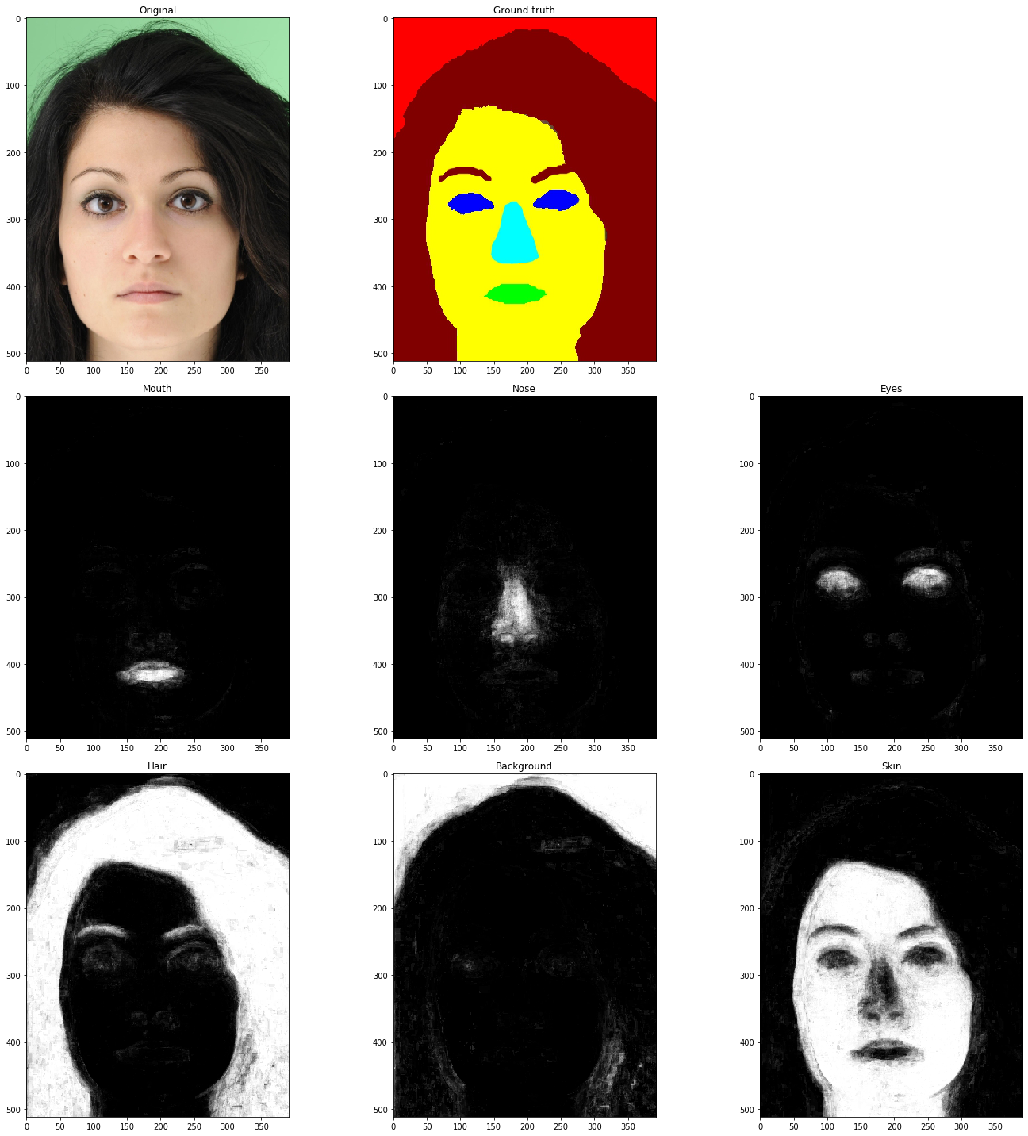
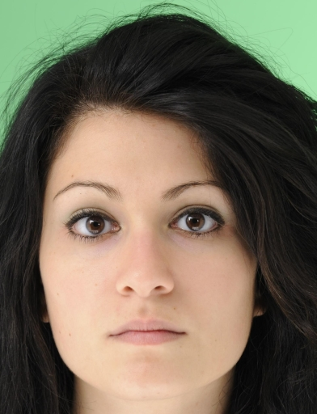
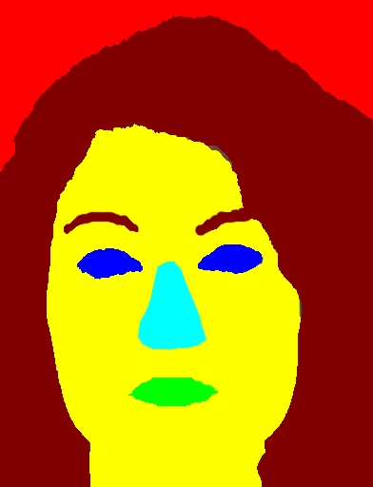
PROBABILITY MAPS EXTRACTION FROM LABELED DATA
1
2
3
4a
4b
Features used
Precision (train | test set)
HoG descriptors
Block of 16x16 computed on 8x8 cells
Value attributed to the center pixel
9 orientations bins
HSV Histograms
Block of 16x16 analysed
16 bins for each histogram
Spatial
Relative location for x and y coordinates on the image
Mouth
RF⁽²⁾: 97% | 80%
LR⁽³⁾: 36% | N.A.
Hair
RF: 98% | 91%
LR: 84% | 77%
Nose
RF: 99% | 84%
LR: N.A.
Background
RF: 98% | 97%
LR: 85% | 93%
&
Eyes
RF: 98% | 92%
LR: N.A.
Skin
RF: 95% | 86%
LR: 82% | 80%
Note: (1) Overall accuracy train vs. Test (RF: 97% | 89% & LR: 83% | 79%)
(2) RF: RandomForest (n_estimators: 50, min_samples_leaf: 100)
(3) LogisticRegression (C=0.1)

Slide 13


GENDER DETECTION
1
2
3
4a
4b
Steps for feature extraction and models used
F1-score (test set)
Detect keys points from labels
Corners of nose, mouth, eyes, skin
Features
Volumes of each label
Distances between key points
Models used
Random Forest
SVM
Random Forest / SVM
Gender Detection
F
RF: 83%
SVM: 77%
M
RF: 80%
SVM: 76%
d
distances
volumes

Slide 14
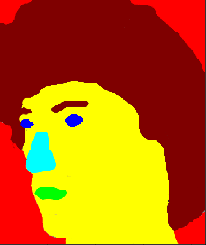

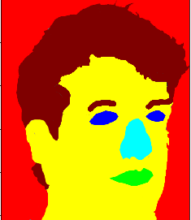
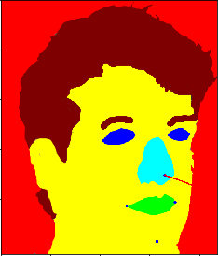
HEAD POSE ESTIMATION
1
2
3
4a
4b
Steps: head pose estimation
Detect 6 points from labels
Corners of nose, mouth, eyes, skin
Extract head position with PnP (Perspective-n-Point)
3D locations - reference frame¹
Camera data approx.:
focal lengths = frame size
optical center = frame center
detect points
PnP
Accuracy on dataset : 96% | 82 images / 85 files
Note: (1) World coordinates from OpenCV docs

Slide 15
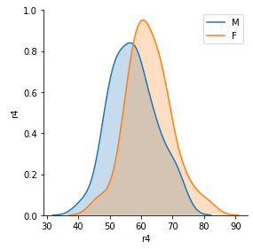
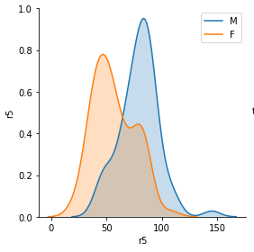
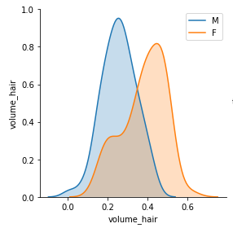
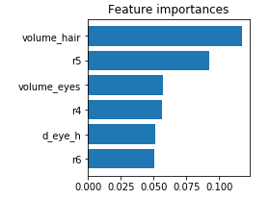
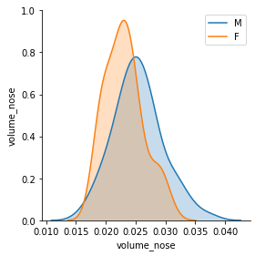
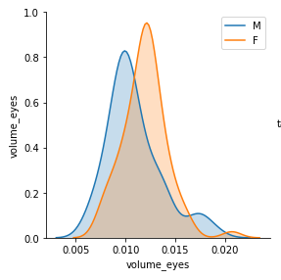
APPENDIX : GENDER DETECTION KEY FEATURES
1
2
3
4a
4b
Feature importances
Densities F vs. M
Legend
r4 : dist. eye - nose
r5 : dist. skin - eye (left)
r6 : dist. skin - eye (right)

Slide 16
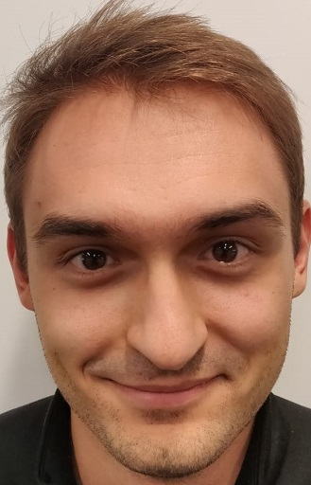
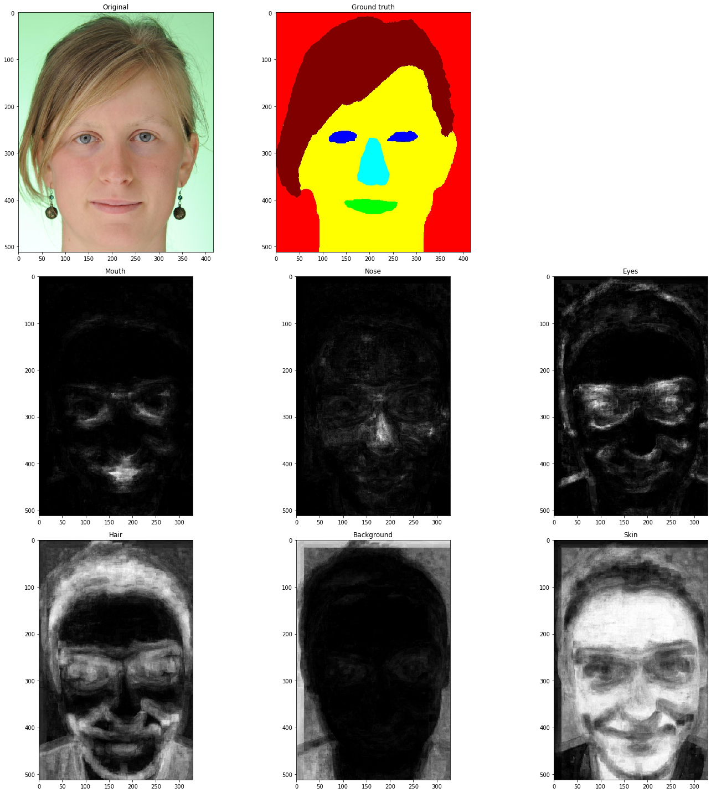
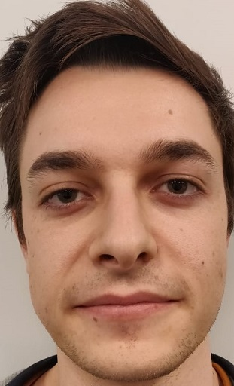
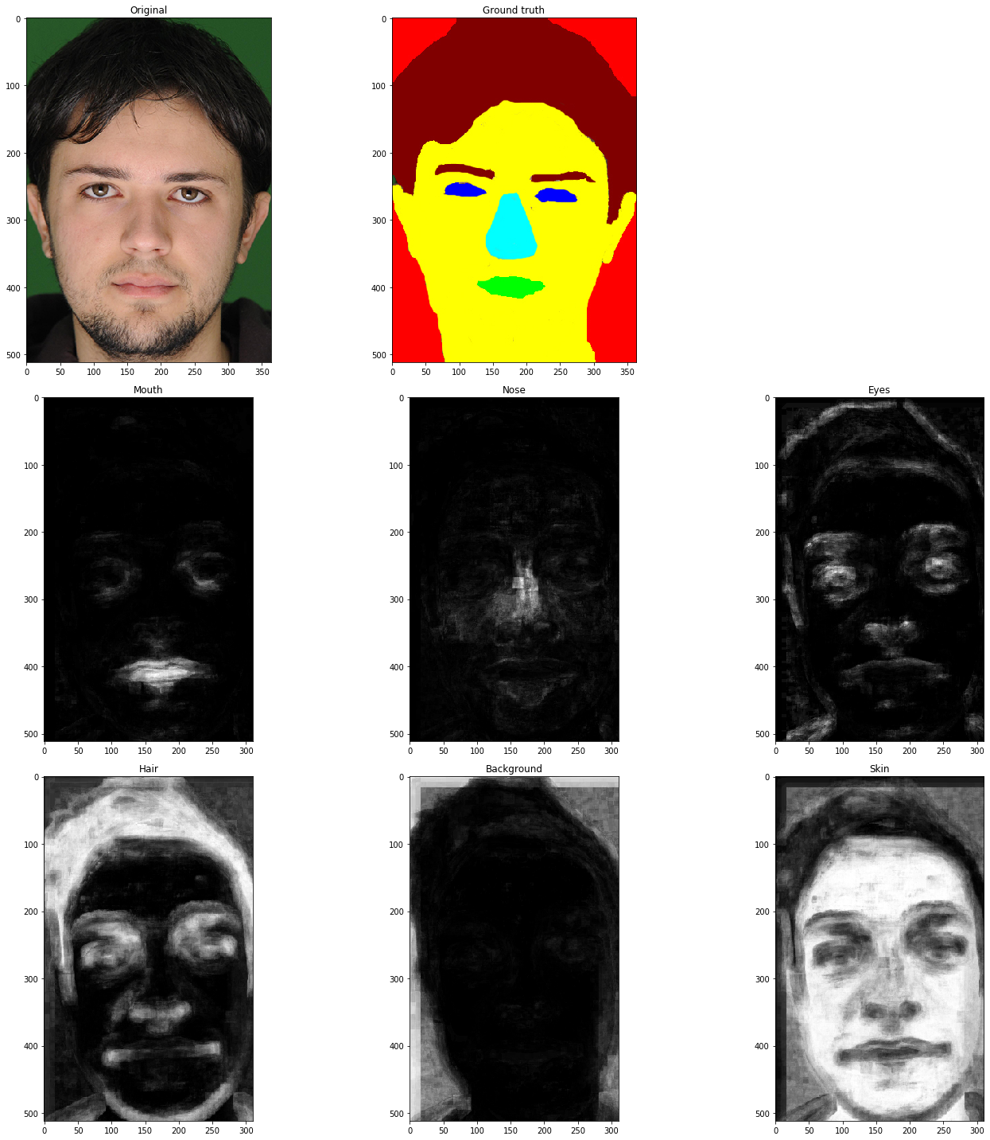
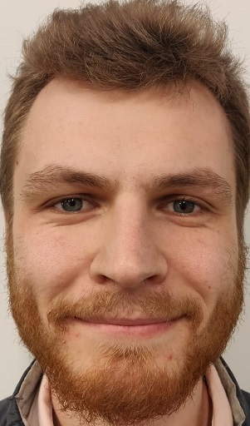
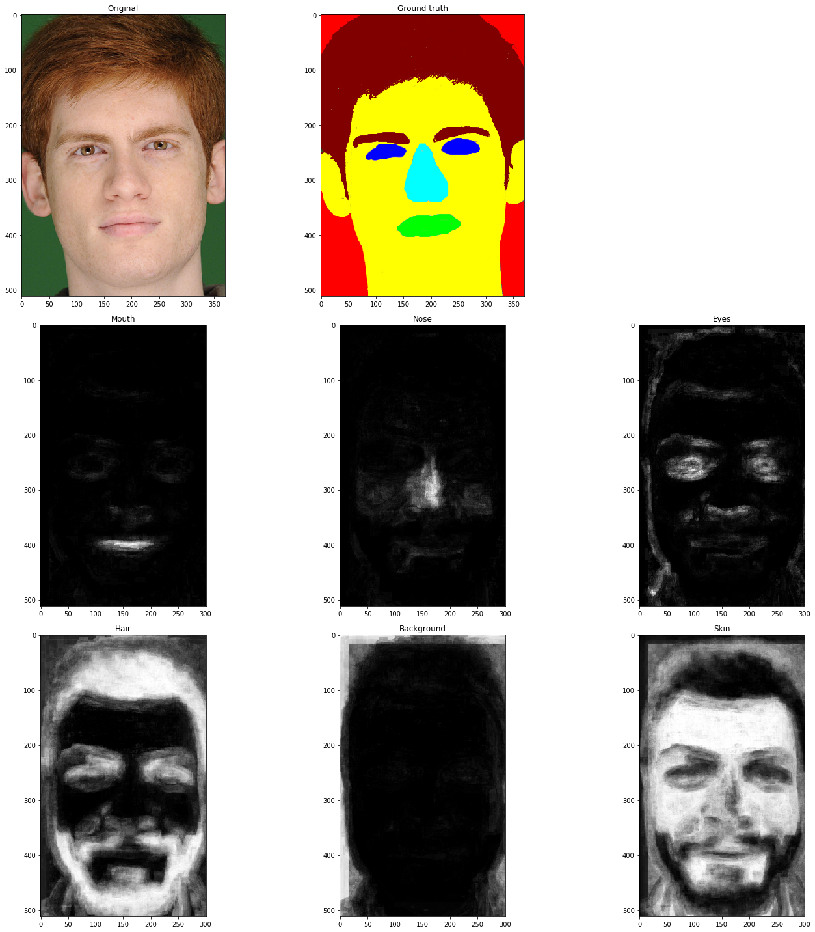
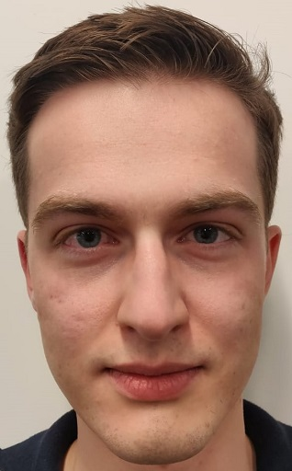
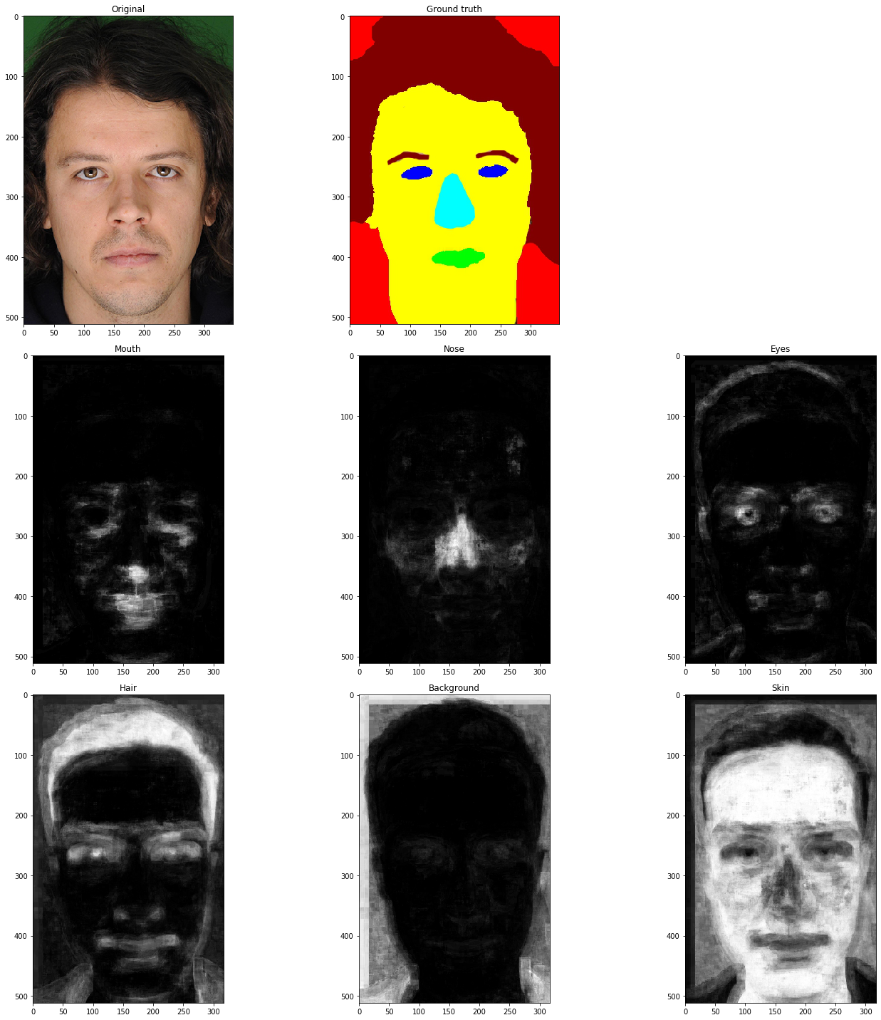
APPENDIX – PROBABILITY MAPS ROBUSTNESS WITH OTHER DATA
A
B
C
D

Slide 17
APPENDIX – PROBABILITY MAPS FEATURES SELECTION PROCESS
Features combination | Macro Acc. (Train) | Macro Acc. (Test) | Weighted Acc. (Train) | Weighted Acc. (Test)
Spatial + HoG | 73% | 55% | 90% | 78%
Spatial + HSV | 90% | 63% | 96% | 87%
HoG + HSV | 79% | 60% | 93% | 84%
HoG | 47% | 28% | 71% | 46%
HSV | 75% | 54% | 92% | 82%
Spatial + HSV + HoG | 89% | 70% | 96% | 88%
Note: Using a RandomForestClassifier
(n_estimators: 10, min_samples_leaf: 100)

Slide 18
BIG CONCEPT
Bring the attention of your audience over a key concept using icons or illustrations

Slide 19

A PICTURE IS WORTH A THOUSAND WORDS
A complex idea can be conveyed with just a single still image, namely making it possible to absorb large amounts of data quickly.

Slide 20
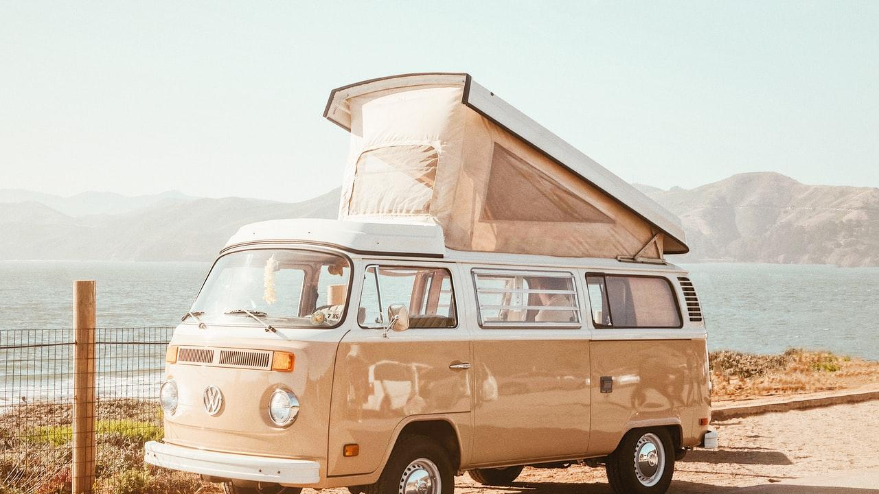
WANT BIG IMPACT?
Use big image

Slide 21
SlidesCarnival icons are editable shapes. This means that you can:
Resize them without losing quality.
Change fill color and opacity.
Change line color, width and style.
Isn’t that nice? :) Examples:

Slide 22
Now you can use any emoji as an icon!
And of course it resizes without losing quality and you can change the color.
How? Follow Google instructions https://twitter.com/googledocs/status/730087240156643328
😉
✋👆👉👍👤👦👧👨👩👪💃🏃💑❤😂😉😋😒😭👶😸🐟🍒🍔💣📌📖🔨🎃🎈🎨🏈🏰🌏🔌🔑 and many more...

